Slide 1

Student
Management
System

Slide 2
Introduction
Student Management Application is designed to make daily tasks of students easier and convenient. It can be used to facilitate our institution with daily routine activities which require manual work.
This mobile application have features which are given below ::
Attendance
Exam Schedule
Report Generator
Notification to Parents
View Notices
View Files
Each of these features is bounded with their functionality. Thus it could be of great importance for both teachers and students.

Slide 3


Slide 4


Slide 5


Slide 6
Objective
Student Management System is designed to make daily task of students easier and convenient.
Students can view their attendance on each subject, marks for every examination conducted in that institution and the parents will also be informed about that.
This allows students as well as parents to stay up to date with their progress. Using mobile application will save a student’s and teacher’s time.
Student will be up to date about the current information about their college.
Student can view their marks of the exam without going to the teacher because sometimes the teacher may not in their cabin or may be delivering the lecture in the other class.
Using this application both student and teacher save their time.

Slide 7
Existing System
A lot of paper used for attendance.
Attendance Records are not centralized.
No System to get organized data from attendance, academic .
Records and their relations.
Students have to go to teacher to ask for their attendance count.
This process is very time consuming.
Student don’t know their rank in each subject.
Students don’t know each others marks.

Slide 8
Proposed System
Attendance is done online, no paper is wasted
All data is centralized
Records from years ago can be accessed in seconds.
Attendance data can be extracted for comparisons and charts/graphs can be drown out of them instantly
Relation between attendance, Marks scored, subject, branch and year can be calculated easily.
Students can view their marks from home
Students can compare their marks with others and can see their performance

Slide 9

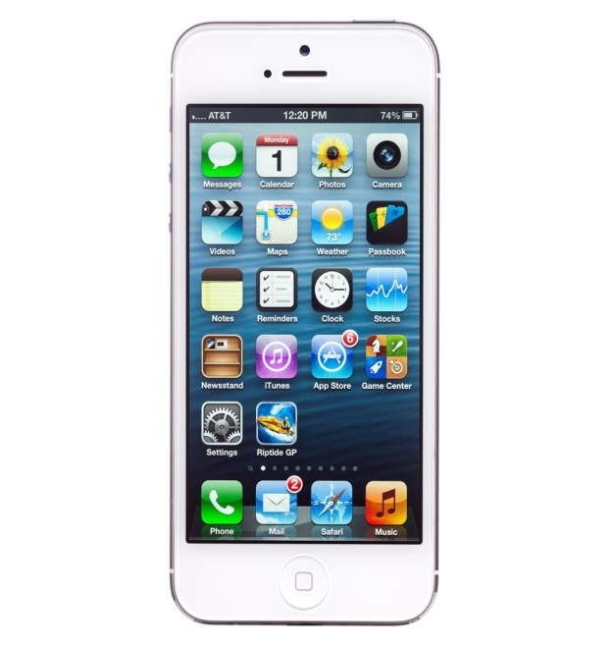
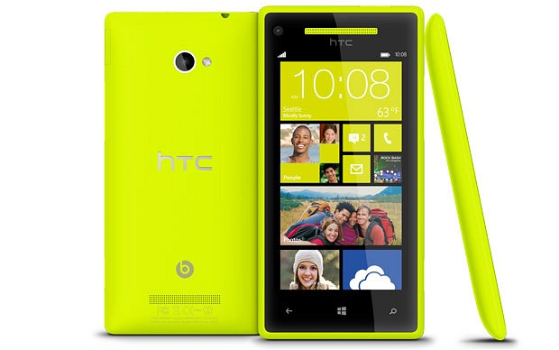
Scope of the Application
This application can run on any platforms.

Slide 10
Required Tools
Hardware Requirements
For Student
A mobile phone with any operating system.
Ram 512mb
Free space 10mb
Processor 1.2GHz
For Teachers
A computer/Laptop with a web browser

Slide 11
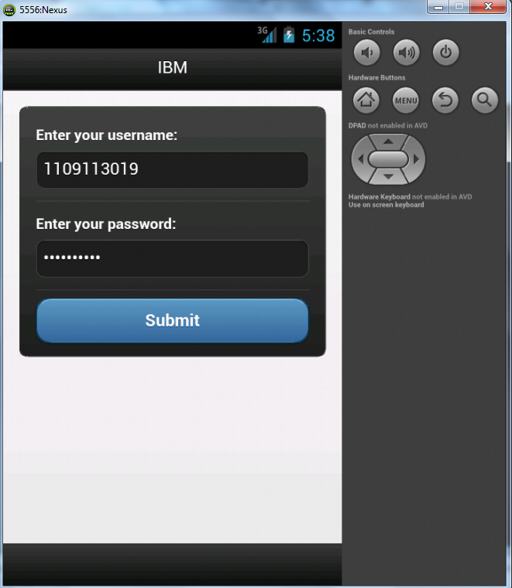
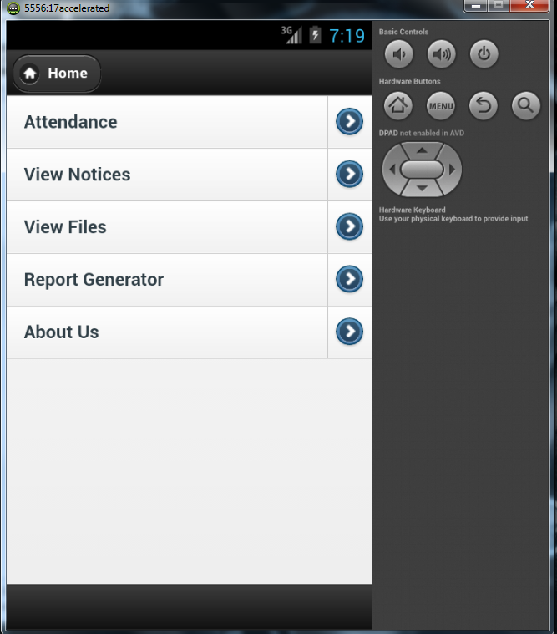
Snapshots

Slide 12
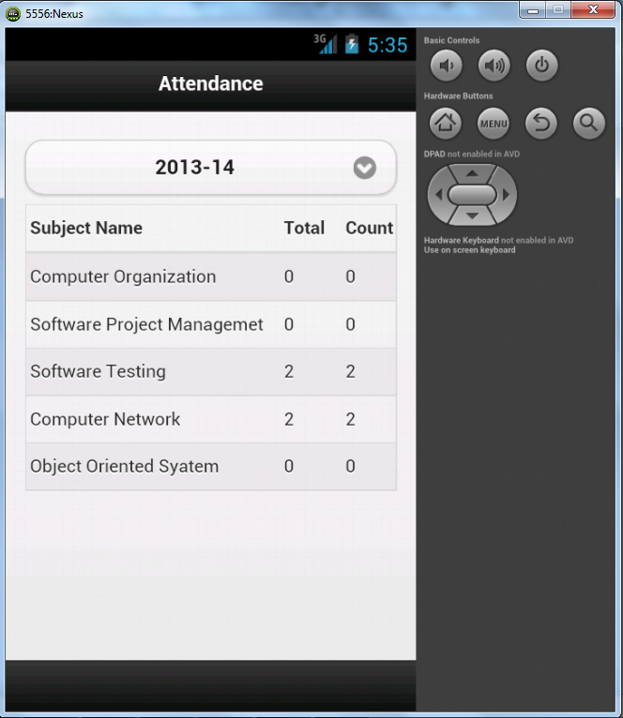
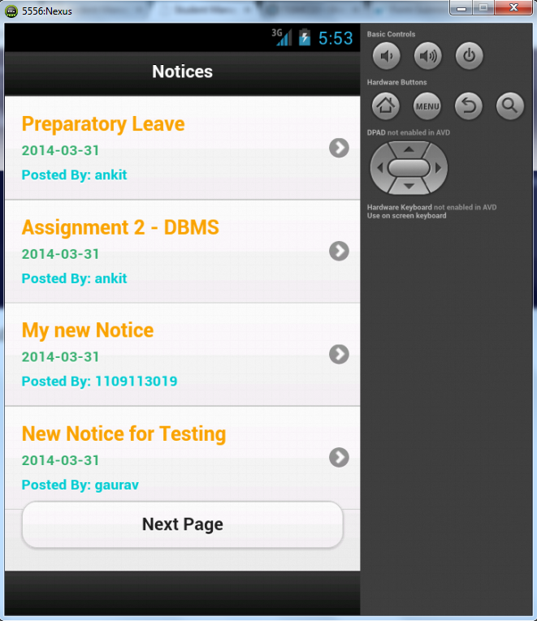
Snapshots

Slide 13
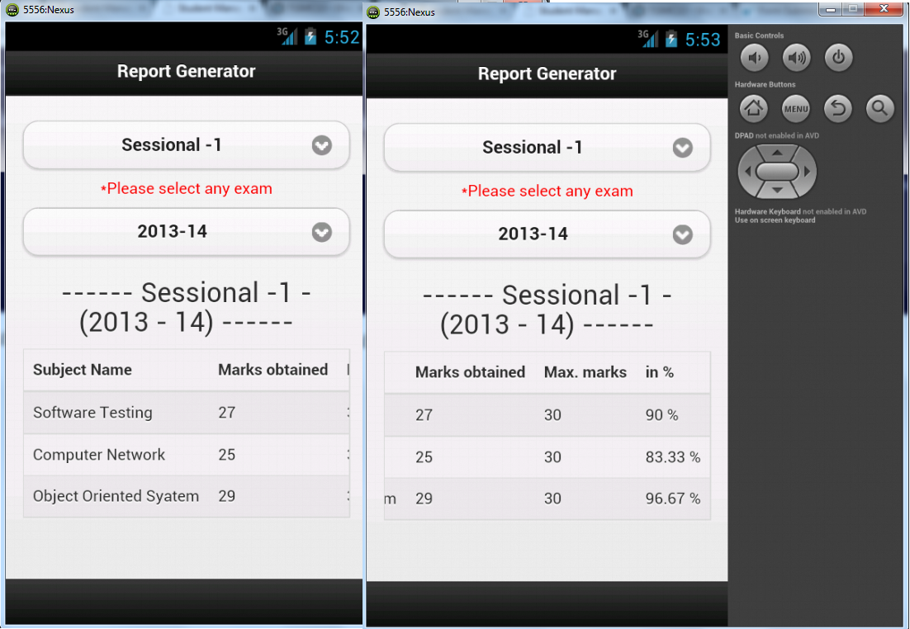
Snapshots

Slide 14
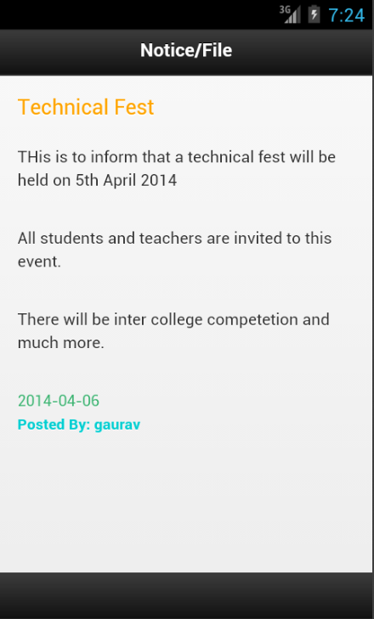
Snapshots

Slide 15
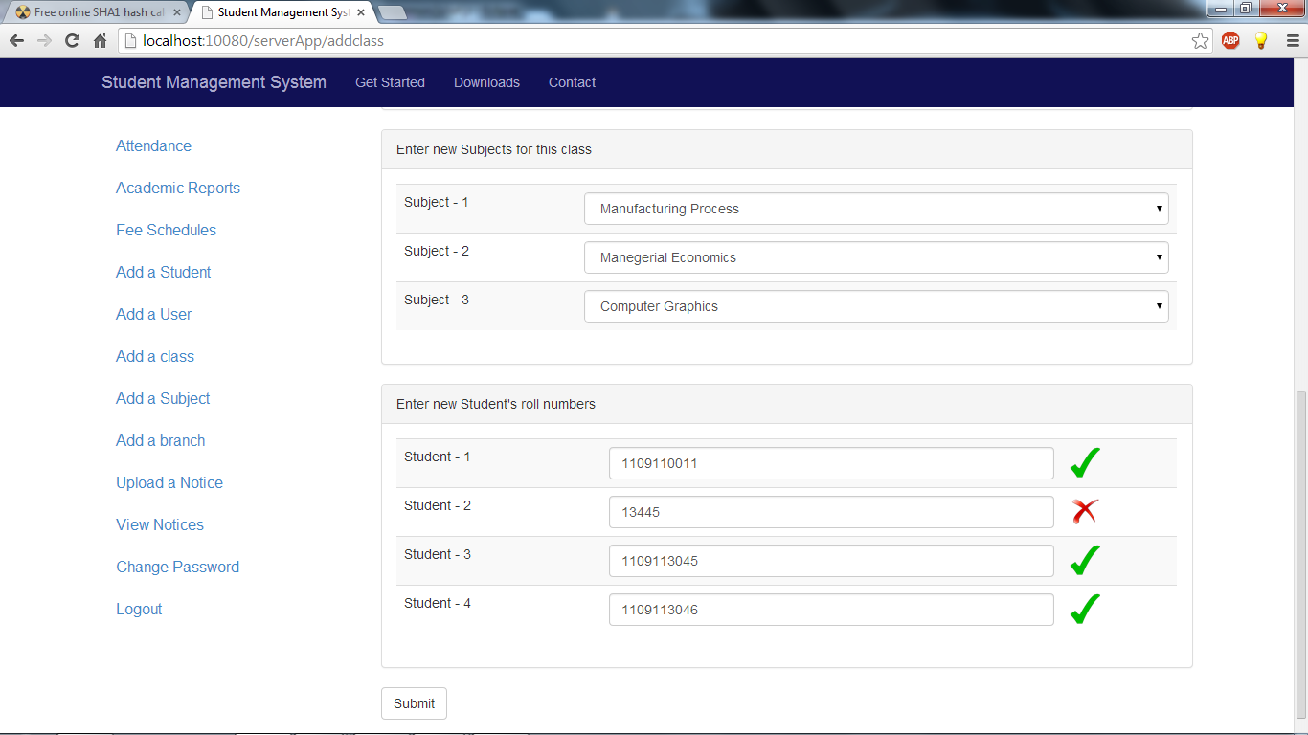

Slide 16
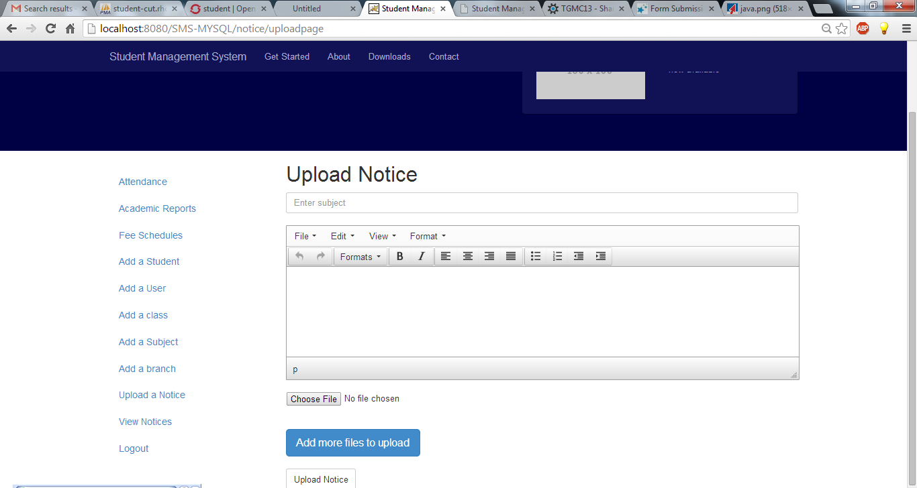

Slide 17
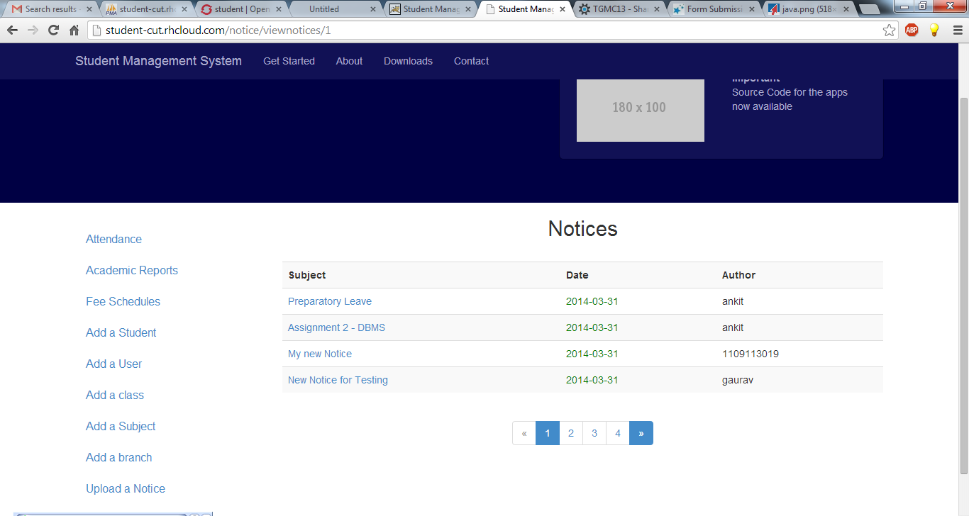

Slide 18
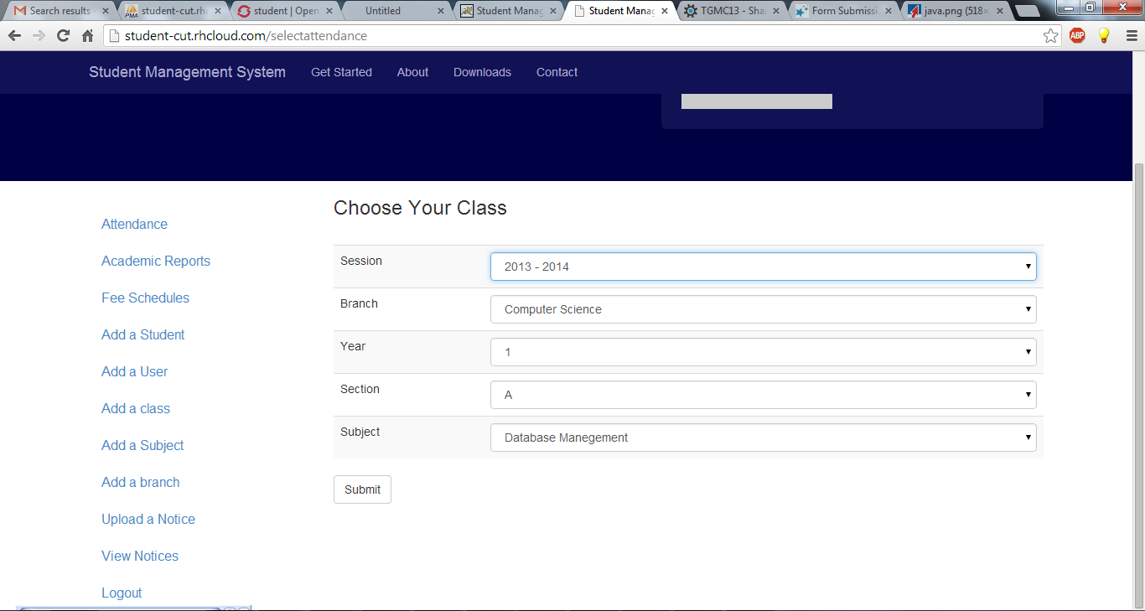

Slide 19
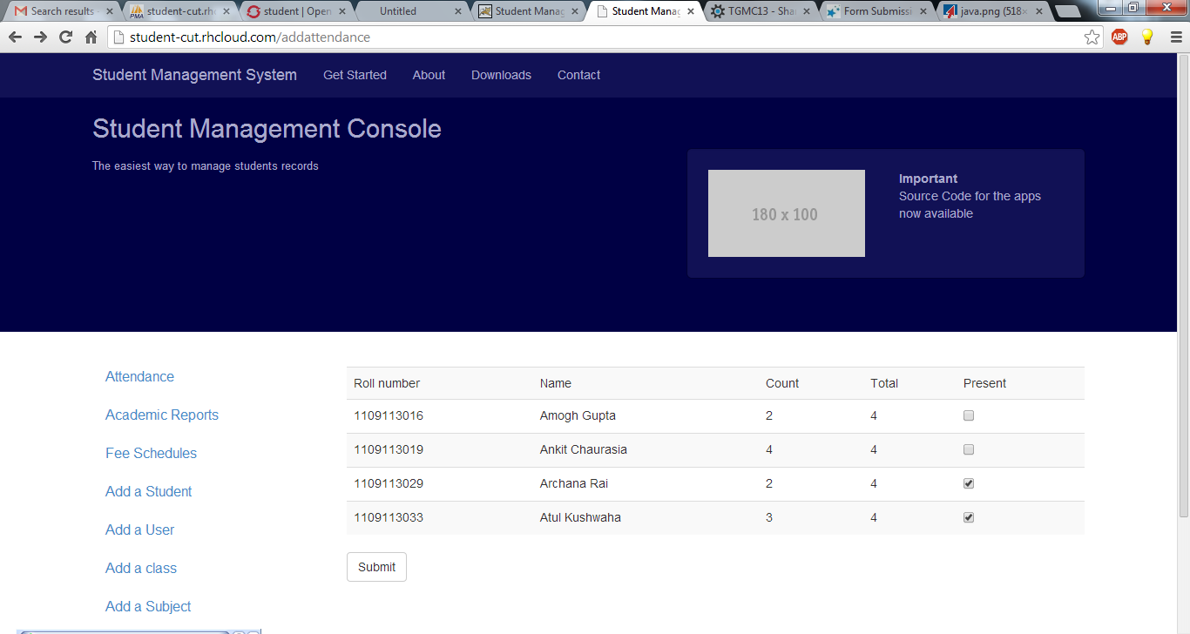

Slide 21
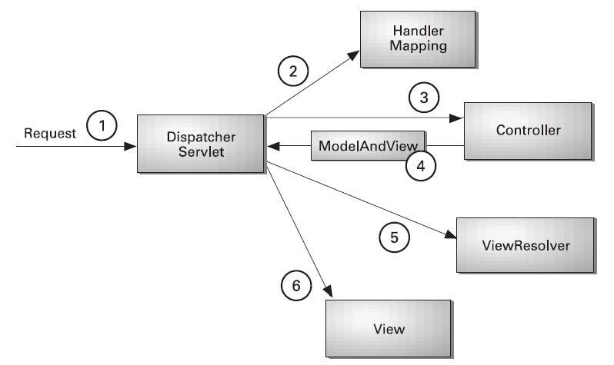
Spring MVC

Slide 22
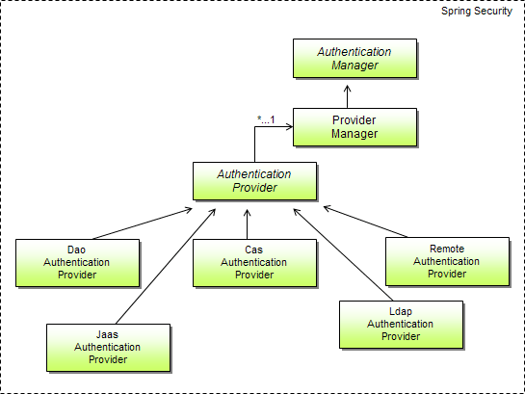

Slide 23
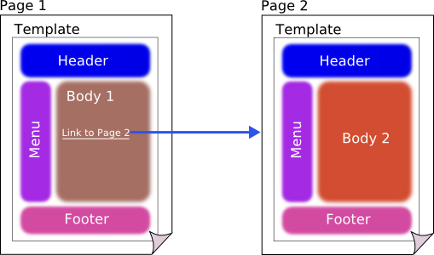
Tiles Framework

Slide 24









Technologies Used

Slide 25
Thank you!!!

